Slide 1




ML MODEL:
PREDICTING HIRING OUTCOMES AND SALARY EXPECTATIONS
2322478

Slide 2


OUTLINE OF PRESENTATION
Problem Statement
Introduction
Project Flow
Implementation
Result
Conclusion

Slide 3
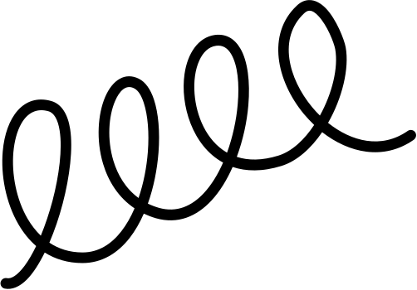
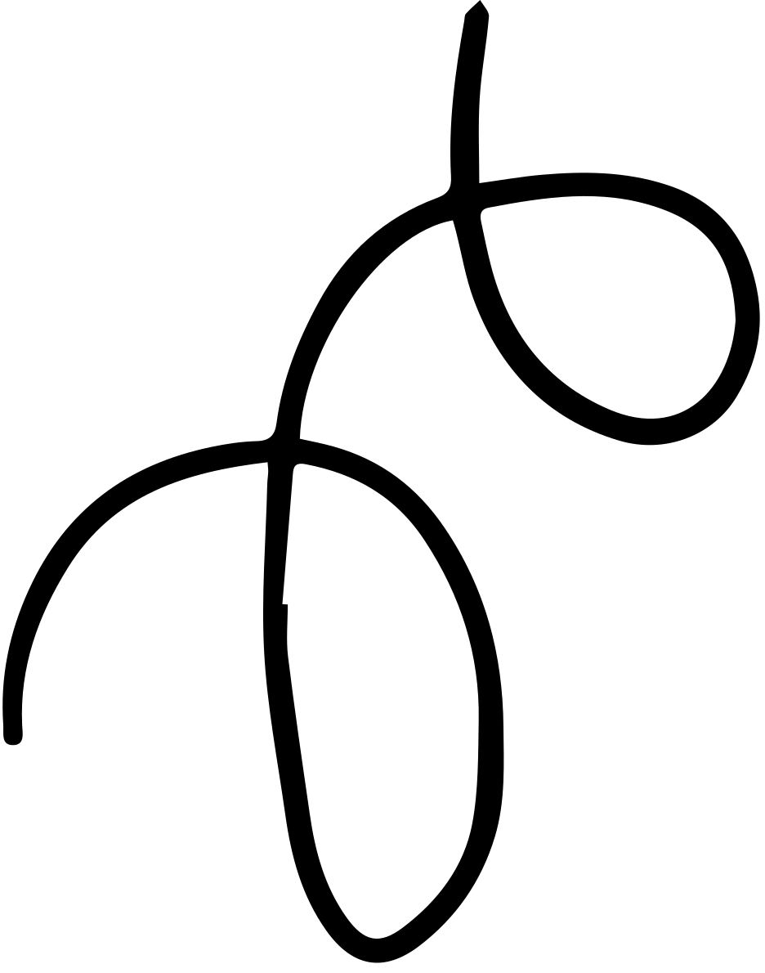
PROBLEM STATEMENT
Predict hiring decisions and estimate salaries based on hiried status.

Slide 4



INTRODUCTION
Objective: Predict hiring decisions and estimate salary expectations using supervised machine learning to enhance recruitment strategies.
Methodology: Utilize candidate attributes like age, gender, experience, education level, skills, and interview performance for accurate predictions.
Impact: Empower candidates with insights to prepare effectively, negotiate salaries confidently, and strategically plan career development.

Slide 5

PROJECT FLOW
Project
Hiring model
Salary model
test data
Predict Salary

Slide 6



Hiring model
EDA
-- key statistics
-- distributions
-- relationships between variables
Data Collection
-- Hiring dataset from Kaggle
Pre-
processing
Model Evaluation
-- accuracy
-- precision
-- recall -- f1-score
Model training
--Logistic Regression
-- SVM
-- Decsion Tree
-- Random Forest
Finalizing the Best Model

Slide 7
Salary model
Processing
Data
-- removing nan values
-- handling the categorical values
Model training
--Linear Regression
-- Decsion Tree
-- Random Forest
Data Collection
-- Salary dataset from Kaggle
Predicting Salaries
-- hiried candidates
Model Evaluation
-- accuracy
-- mae
Finalizing the Best Model

Slide 8
Implementation &
Results

Slide 9
CONCLUSOIN
Developed predictive models to enhance recruitment strategies, forecasting hiring decisions and estimating salary expectations.
Found that salaries are primarily influenced by years of experience and age, with older, more experienced candidates earning higher salaries.
Identified education level, skill score, and personality score as the most influential factors in hiring decisions.
Random Forest Classifier emerged as the best model for predicting hiring decisions, with an accuracy of 93.33%.
Linear regression showed the highest accuracy (90.04%) for salary prediction, indicating a strong linear relationship between predictors and salary.
Provided valuable insights for candidates and employers, improving preparation, negotiation, and decision-making in the recruitment process.

Slide 10
THANK YOU

